Slide 1
PS ID: 02
PS Title: Efficient Management, Disposal and Recycling of E-waste
Team Name: Kleos Tech
Team Leader Name: Omkar Dinesh Mhatre
Institution Name: Fr. Agnel Polytechnic, Vashi
Segment: PS-Based

Slide 2
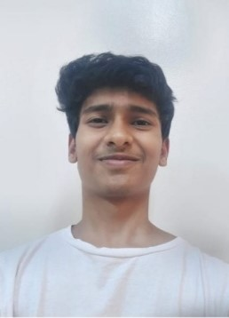

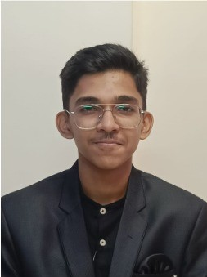

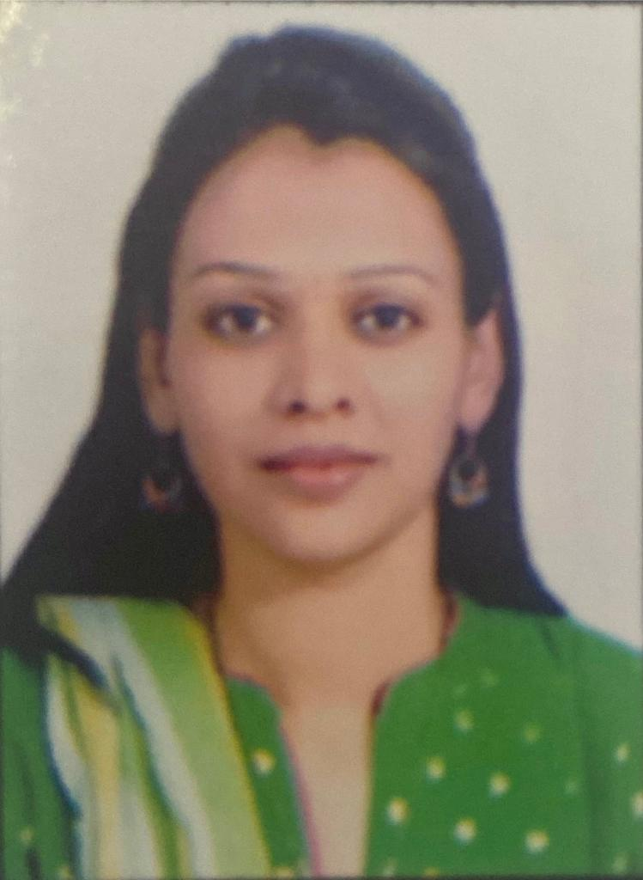
Meet the Team
Omkar Mhatre
Soham Dhanokar
Anshul Vethekar
Niharika Walunj
Rashmi Dhake

Slide 3
IDEA / APPROACH DETAILS
User-friendly login interface for citizens and an interface for E-Waste Management agencies ensuring input of necessary credentials of both the citizens as well as the agencies.
Citizen profiles containing dashboard which will comprise of citizens’ details, E-tokens, E-Quests, E-Wallet, disposal history and collection status.
E-waste Agency profile containing information related to the agency, disposal history, and
collection status, ratings ,reviews.
E-Waste Agencies section for citizens to explore, select and view different agencies to choose the most appropriate agency to collect or drop off e-waste according to user’s discretion.
Collection status will be displayed and updated in citizen’s and respective agency’s profiles once the collection or drop-off request is accepted. Both the citizen and agency will be notified of the request once it is accepted.
Marketplace section allowing citizens to buy and sell used hardware or components of hardware directly to another citizen.

Slide 4
IDEA / APPROACH DETAILS
E-Token points will be granted to users after completing certain E-Quests. E-tokens will be stored in the E-Wallet and can be used to redeem discounts on products listed in the marketplace.
E-Waste Community section allowing users to connect and interact with each other using group-chat facility. Sub-section for announcements related to e-waste collection drives or educational workshops, etc.
E-Waste Awareness section containing news and articles focusing on awareness of e-waste management and implying its importance in today’s world.
Disposal Certificate will be provided to the citizens when they have disposed off a certain amount of E-waste.

Slide 5
TECHNOLOGY STACK
Front End: HTML, CSS, Java Script, React JS, Redux, Bootstrap
Back End, Connectivity and Hosting: Firebase, Firestore
Maps Services: Google maps, Leaflet JS
Authentication: OAuth 2.0
Shipment Tracking: Wordpress(WPCargo or Woocommerce)

Slide 6
USPs OF YOUR IDEA
Integrated website: E-waste selling and a community interactive platform.
Recommendation or Suggestion: Citizens will be recommended of agencies which they have worked with on past disposals when they explore agencies with a new disposal request.
Exclusive marketplace: E-waste selling platform for citizens to buy and sell used hardware and hardware components directly with each other.
E-token redemption: Citizen will be able to redeem E-tokens in exchange for direct access to NGO events, environmental initiatives such as tree planting.
E-Tokens to create a gamified leaderboard where citizens can unlock levels and badges.
E-tokens can also be used to redeem offers or discounts on products listed in marketplace.

Slide 7
FUTURE SCOPE
Integration of an interactive map showing live collection status for short distance disposal requests and showing nearby E-waste Recycling Agencies.
Integrated AI Chatbot for citizens' queries related to E-waste, its management and its awareness.
Schedule pickup with the E-waste agencies by collaborating with courier services such as dtdc, India post, etc.
Implement a Premium Service where agency pays a monthly or annual fee, which will discard any and all platform charges on any disposals, advertisement of the agency, listing preference in explore agency section.

Slide 8
DEPENDENCIES / SHOW STOPPER
Scalability issues: Free services like firebase have usage limits. Therefore user growth may cause performance issues or downtime.
Real-time notifications and chat systems using Firebase can experience latency or limitations under high traffic.
Free services may not offer advanced security features such as detailed access control, user data encryption, or secure APIs.

Slide 9
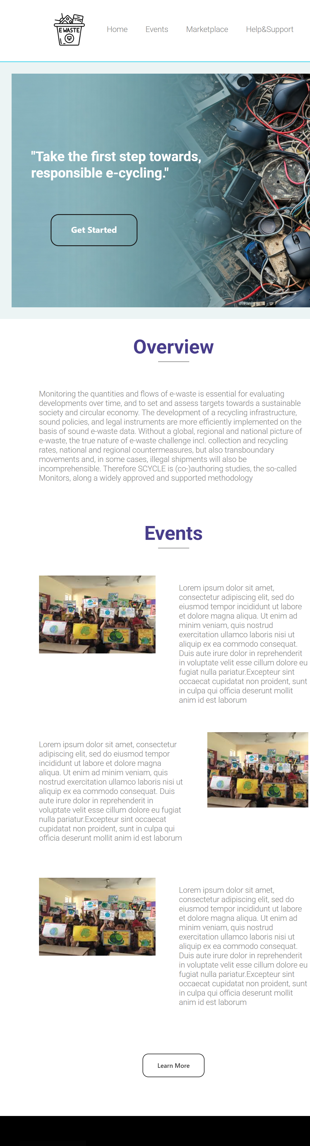
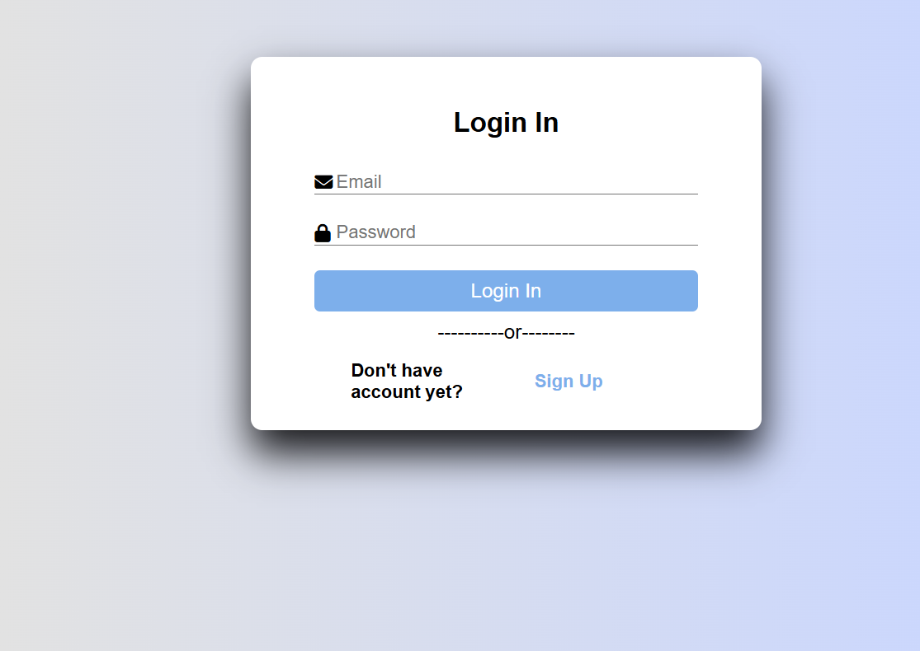
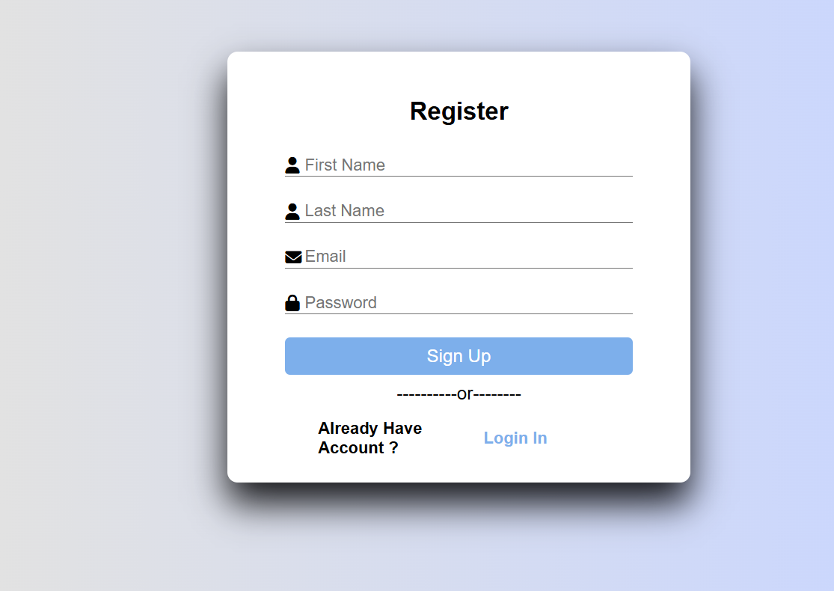
PROGRESS/IMPLEMENTATION
Note: Features which are included in the current prototype are followed by ✅.
Landing Page will comprise of overview, insight of the events section and tabs leading to other sections of the website like Marketplace, Community, etc. ✅
User Friendly Login interfaces, Profiles and Dashboards will be supported by firebase database and firebase-auth providing real-time change of data and security features.✅
Agency Search will also be managed using firebase database, and javascript. User interactions with agencies, like past orders, are logged. Agencies are ranked by recency and frequency to recommend familiar ones.
Collection status will be updated by the agencies via prepared forms with input fields, notes and default inputs, triggering real-time user notifications through FCM. Editable statuses ensure flexibility, stored in Firestore for synchronized updates across interfaces.
Marketplace allows users to list, search, and interact with e-waste items. Sellers can post, edit, and remove listings, while buyers can filter items and contact sellers. firebase firestore handles real-time updates, Firebase Cloud Messaging sends notifications, and status changes are tracked, providing users more control.

Slide 10
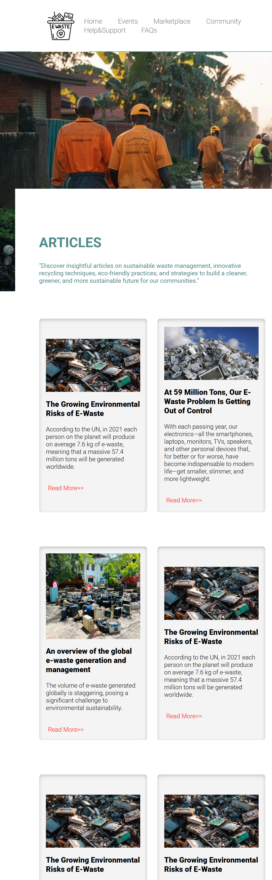
PROGRESS/IMPLEMENTATION
Additionally, engaging floating CTA buttons, texts, etc to redirect and prompt users to get back to disposing off their e-waste will be used in the marketplace.
E-tokens: Users are randomly assigned E-quests from a Firebase collection. Random quests are assigned by fetching all user IDs from Firebase. A random quest is selected from the available pool using a random index, then assigned to the user. Admins can add, edit, or delete quests through a separate interface, and the quests update weekly/monthly. Quests expire after a set time to reduce manual work. E-tokens will be rewarded, stored and updated through firebase firestore.
Community feature will allow users to create/join group chats, store temporary messages with Firestore and sessionStorage, use FCM for real-time notifications, and admins can post announcements with Firestore storage.
E-waste awareness section will contain articles and news as clickable images and text, with CTA buttons such as “read more”, redirecting them to other websites. ✅
Disposal certificate feature generates certificates using a pre-existing PDF layout, with jsPDF or pdf-lib used for updating text fields fetched from Firestore, onto the template.

Slide 11
Team Members
 | Name | Gender
Team Leader | Omkar Dinesh Mhatre | Male
Team Member 1 | Soham Mahendra Dhanokar | Male
Team Member 2 | Anshul Harish Vethekar | Male
Team Member 3 | Niharika Kiran Walunj | Female

